Slide 1
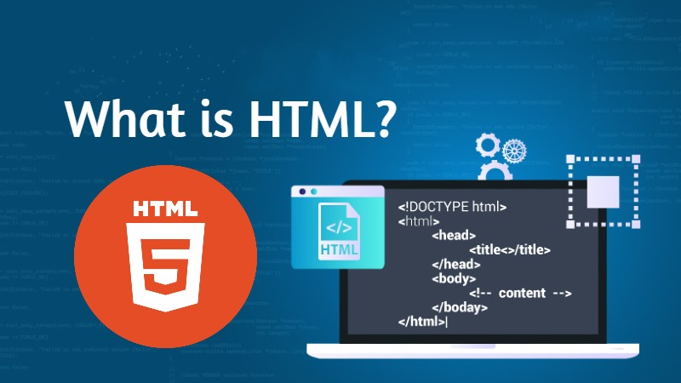

Introduction to HTML
What is HTML?
HTML stands for HyperText Markup Language. It is the standard markup language used to create and structure the content of websites and web pages. HTML is the backbone of web development and is responsible for defining the structure and layout of a webpage's content, such as text, images, videos, links, and other elements.HTML uses various tags to mark up different elements on a webpage. These tags are enclosed in angle brackets (<>) and are used to define the purpose and structure of the content. For example, the <h1> tag is used to define a top-level heading, while the <p> tag is used to define a paragraph.
Why HTML?
Structure: HTML provides a structured way to organize content on a webpage. It allows developers to define headings, paragraphs, lists, images, tables, and other elements, making the content readable and well-organized for users and web browsers.
Universal Language: HTML is supported by all web browsers, making it a universal language for creating web pages that can be accessed and viewed by people using different browsers and devices.

Slide 2
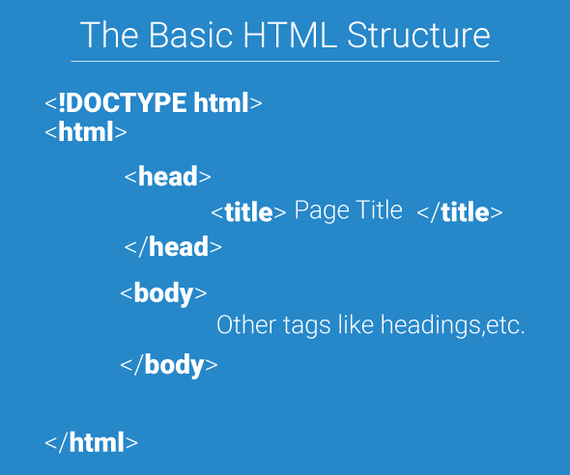
The <!DOCTYPE> Declaration
The <!DOCTYPE> declaration represents the document type, and helps browsers to display web pages correctly.
It must only appear once, at the top of the page (before any HTML tags).
The <!DOCTYPE> declaration is not case sensitive.
The <!DOCTYPE> declaration for HTML5 is:
Basic Structure
HTML Headings
HTML headings are defined with the <h1> to <h6> tags.
<h1> defines the most important heading. <h6> defines the least important heading:
HTML PARAGRAPH
<p>…</p>Insert a line space Before and after a Paragraph

Slide 3
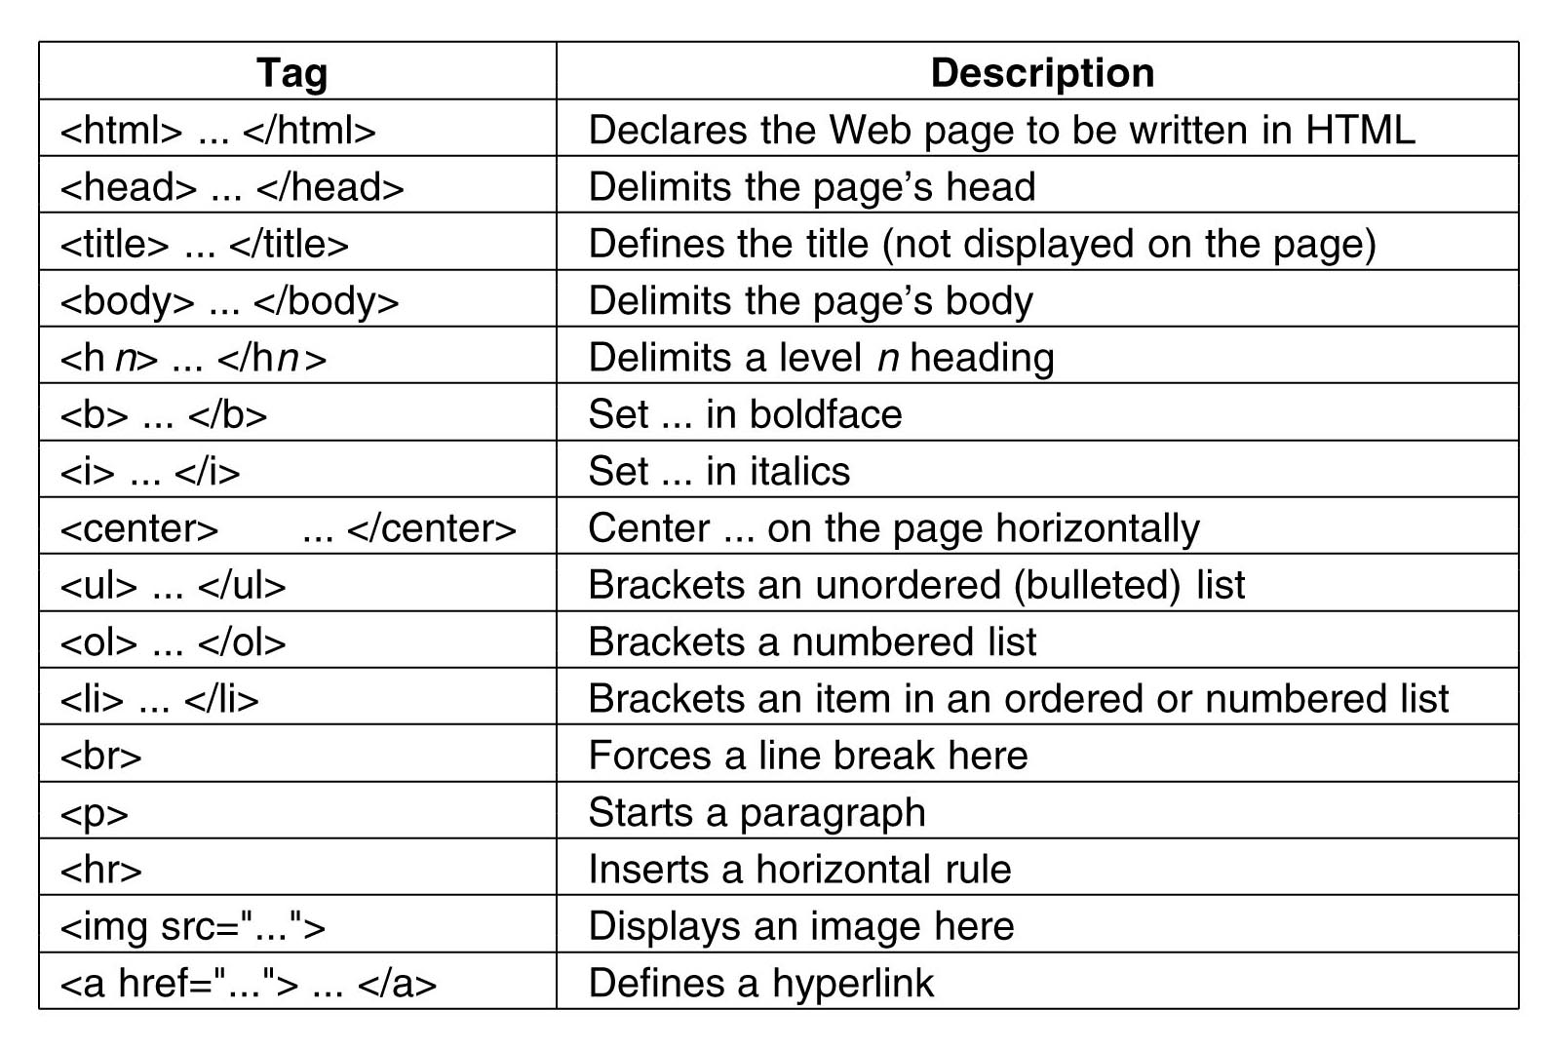
HTML Formatting Elements
Formatting elements were designed to display special types of text:
<b> - Bold text
<strong> - Important text
<i> - Italic text
<em> - Emphasized text
<mark> - Marked text
<small> - Smaller text
<del> - Deleted text
<ins> - Inserted text
<sub> - Subscript text
<sup> - Superscript text
target
Value | Description
_blank | The response is displayed in a new window or tab
_self | The response is displayed in the current window
_parent | The response is displayed in the parent frame
_top | The response is displayed in the full body of the window
framename | The response is displayed in a named iframe
tags

Slide 4
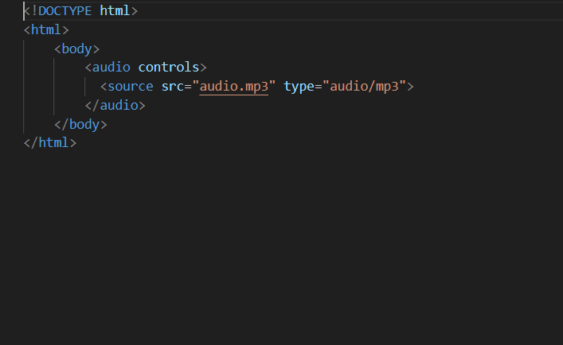

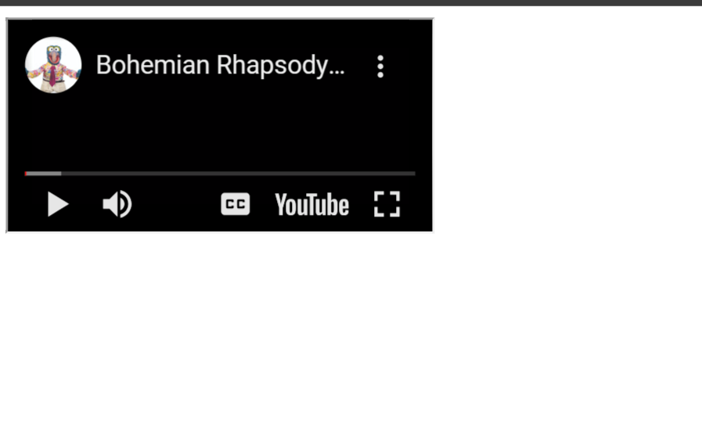
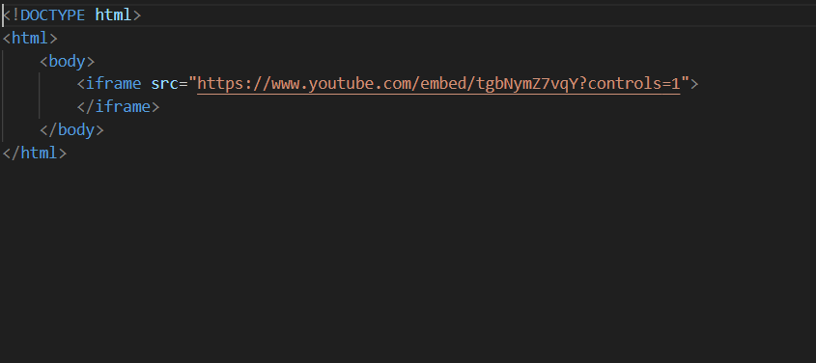
Example for inserting audio and video using HTML

